Slide 1






Software Design and Architecture (SE-211)
VIXEL
ONLINE DESIGN TOOL
Complex Engineering Activity
Presented By:
Zoiba Tabassum (478562)
Hassan Iftikhar (486855)
Jannat Shaheer (472248)
M. Tanveer Haider (486873)
Laraib Zahra (486986)
Muhammad Talha (486869)

Slide 2

CONTENTS
1. Introduction
2. High Level Design
3. Mid Level Design
4. Low Level Design
5. Design Patterns

Slide 3

INTRODUCTION
CASE (Computer Aided Software Engineering) Tool
Requirement Analyzer
Diagramming Engine
Code Generator
Testing
Maintenance

Slide 4
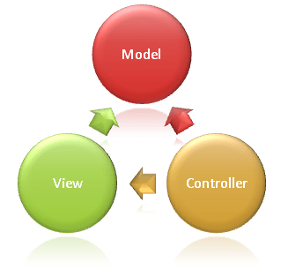
HIGH LEVEL DESIGN
System Overview
Model: Core logic, processing, code generation
View: User interface
Controller: Handles input, routing
Rationale of Selecting MVC
Scalable and modularity
Clean separation
Reusable

Slide 5

MODULE DESCRIPTION
REQUIRMENT ANALYZER
Captures and validates functional and non-functional requirements.
Converts user input into a structured format.
Passes clean data to the diagramming and code modules.
DIAGRAMMING ENGINE
Enables users to visually model system architecture (e.g., UML).
Supports drag-and-drop creation and editing of diagrams.
Syncs with requirements and aids code generation.
CODE GENERATOR
Converts diagrams and structured data into source code.
Uses language-specific templates for consistency.
Automates creation of class skeletons and method stubs.
TESTING
Performs unit and functional tests on generated code.
Displays results and highlights failures for debugging.
Ensures the generated code meets project expectations.
MAINTENANCE
Manages version control and tracks changes in diagrams/code.
Supports refactoring, updates, and design evolution.
Ensures long-term maintainability of the software project.

Slide 6
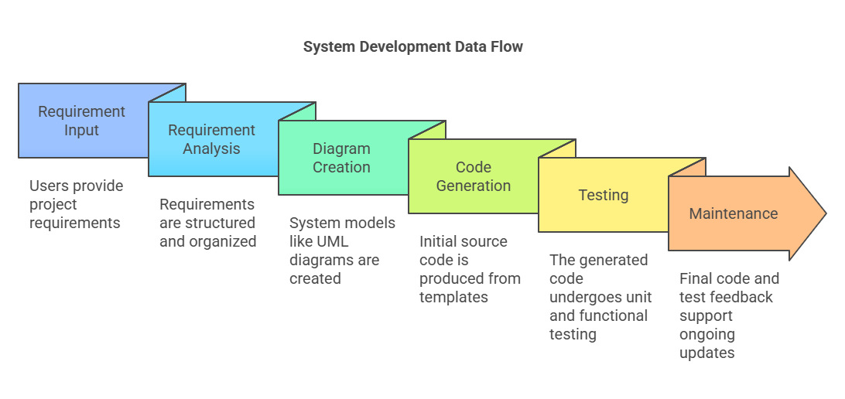
DATA FLOW OVERVIEW

Slide 7
DEPLOYMENT ARCHITECTURE
Client (View layer)
Built with React/Vue for responsive UI
Users can input requirements, create diagrams, and view code/tests
Communicates via RESTful APIs
Server (Controller Layer)
Manages application logic and user sessions
Routes requests to modules: Requirements, Diagrams, Code, Testing, Maintenance
Implements secure, modular REST API endpoints
Backend (Model Layer)
Processes core logic and data
Handles diagrams, code templates, and test results
Interfaces with the database for persistent storage
Database
Stores users, project data, diagrams, generated code, and test logs
Supports PostgreSQL or MongoDB for flexible storage needs
Hosting & Deployment
Cloud-ready: Deployable on AWS, GCP, Azure
Supports Docker & optional Kubernetes for containerization
CI/CD pipelines for continuous delivery and testing

Slide 8
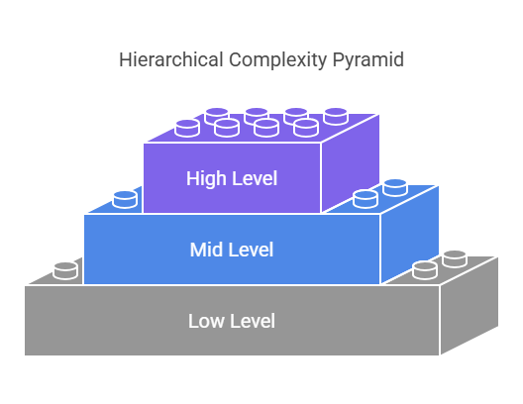
MID LEVEL DESIGN
User Interface Design

Slide 9
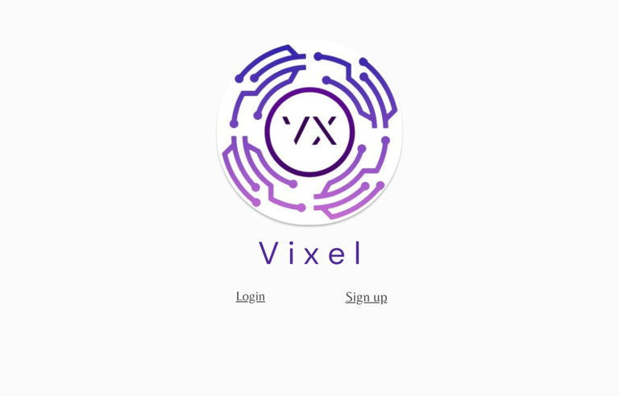
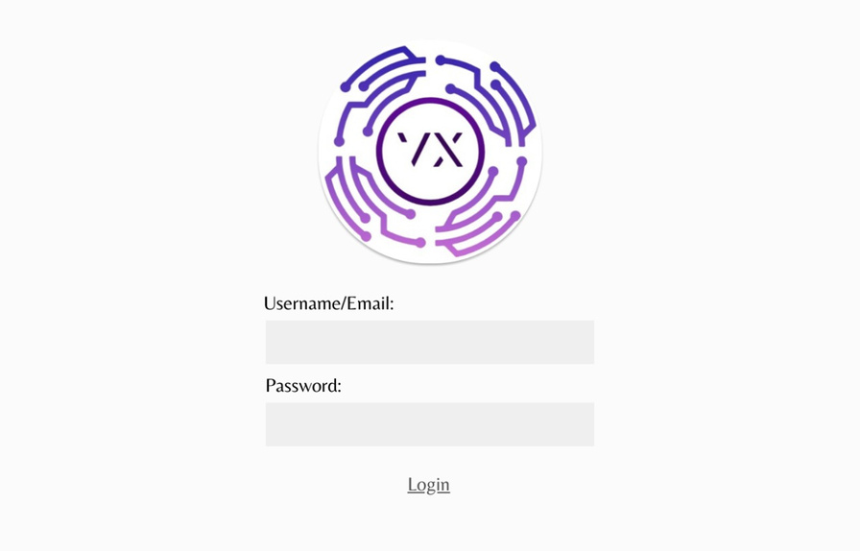
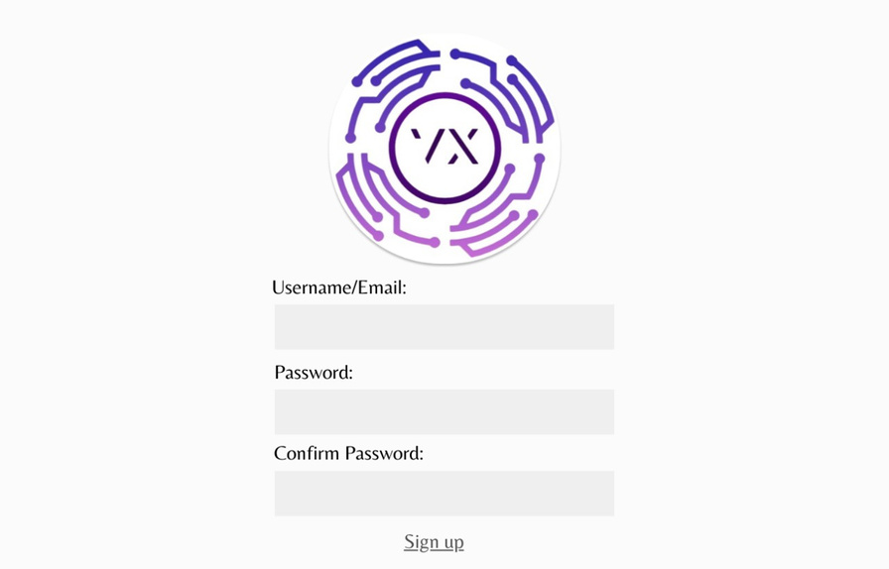
LOGIN AND SIGNUP

Slide 10
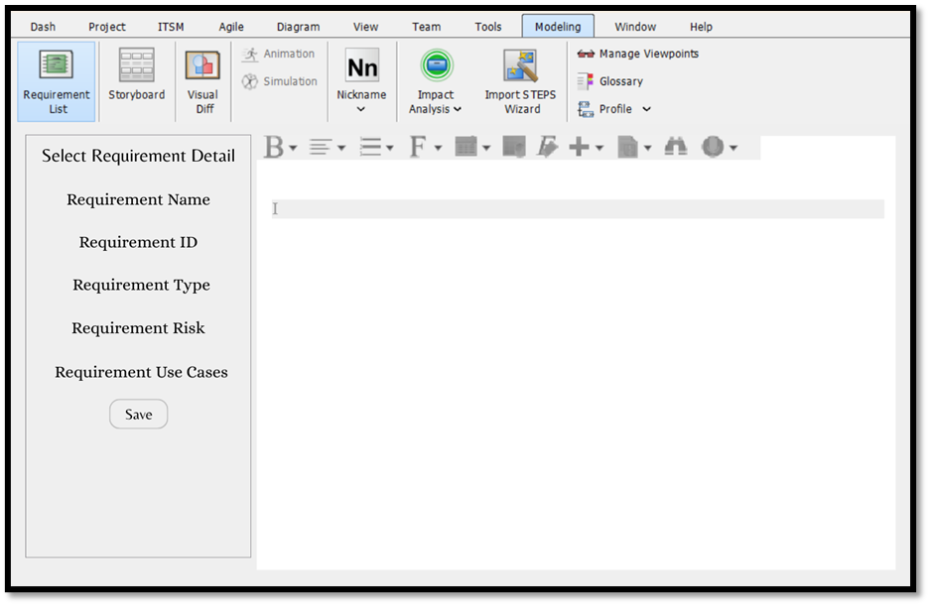
REQUIREMENT ANALYZER

Slide 11
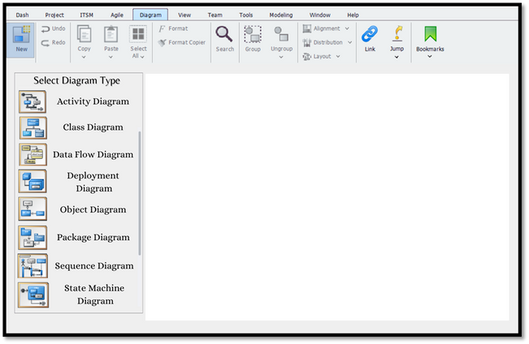
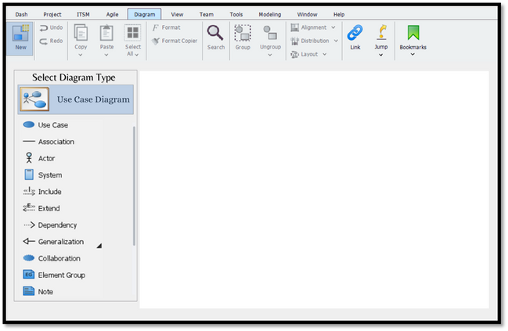
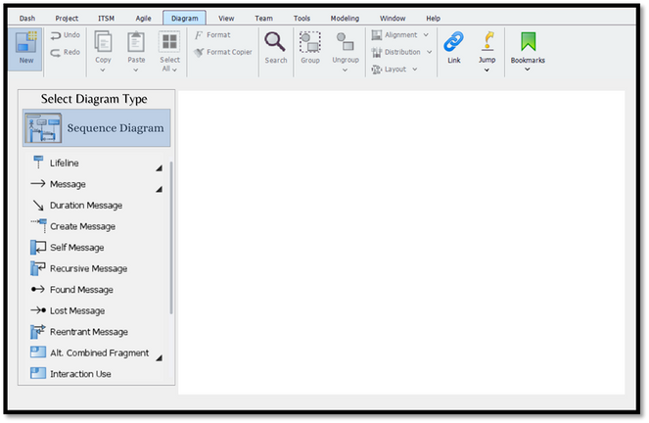
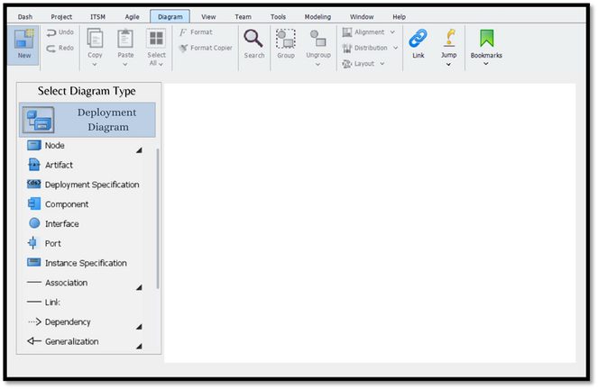
DIAGRAMMING ENGINE

Slide 12
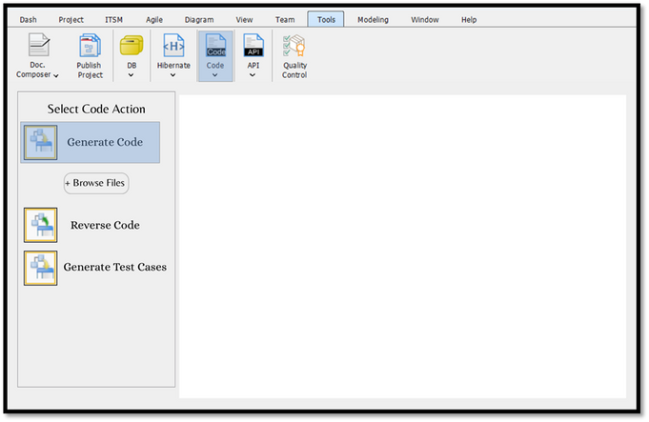
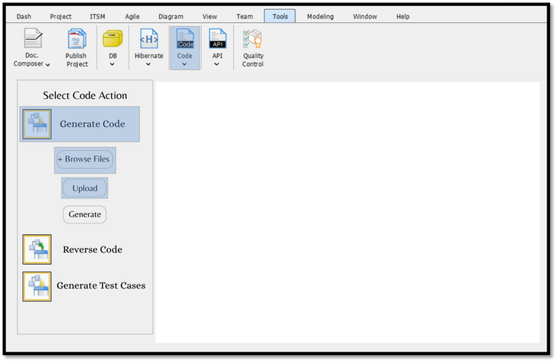
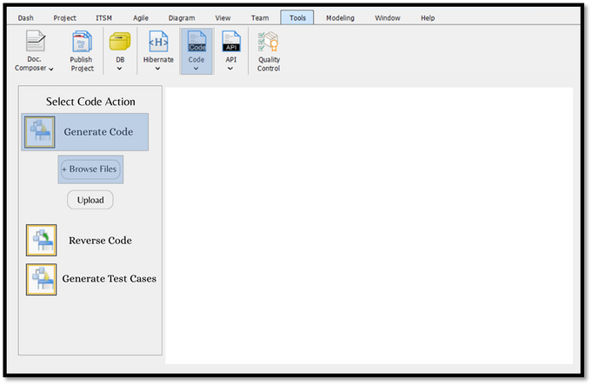
CODE GENERATOR

Slide 13
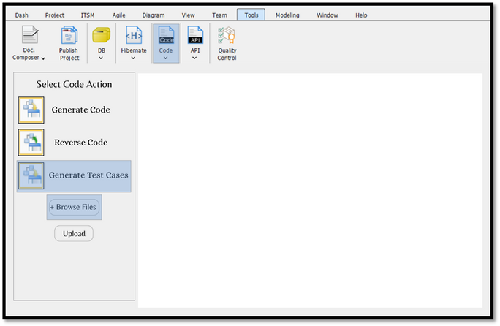
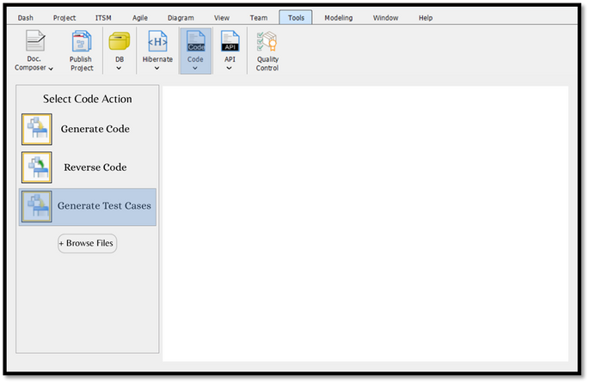
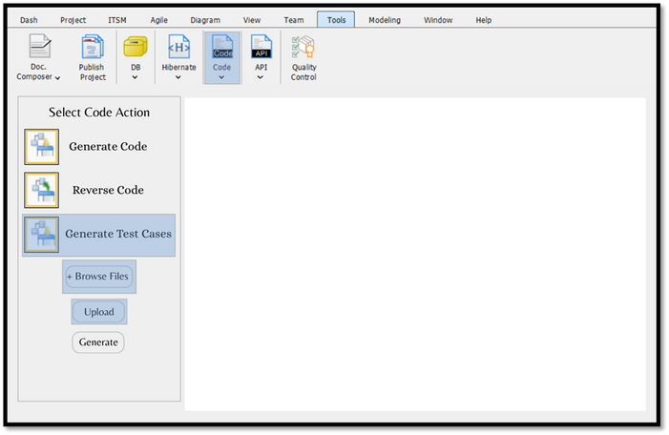
TESTING MODULE

Slide 14
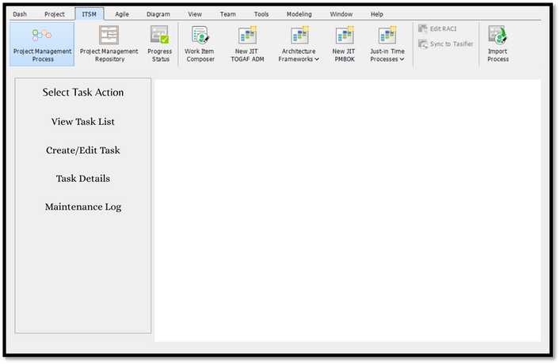
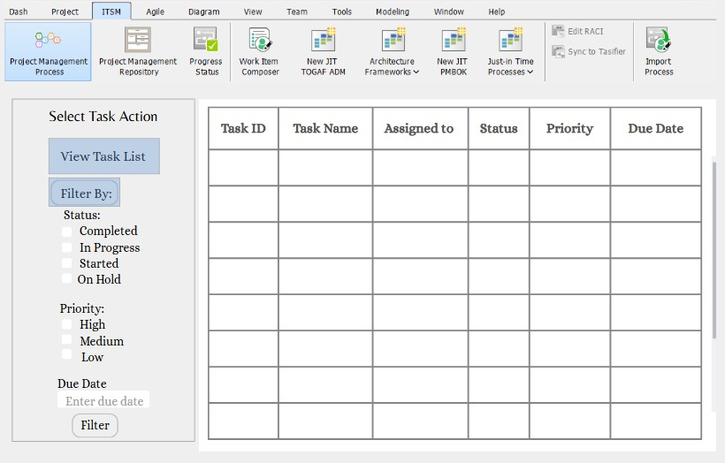
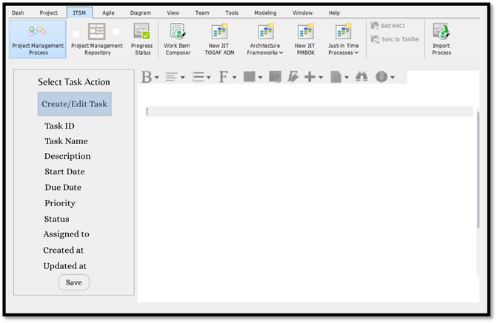
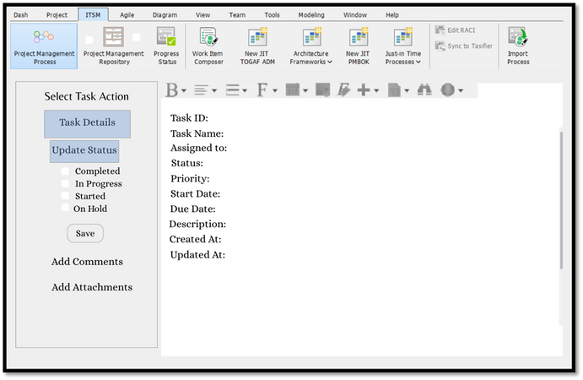
MAINTENANCE MODULE

Slide 15

LOW LEVEL DESIGN
Classes and methods structure
Database schema and relations
Class diagrams
Applied design patterns overview
Module-wise implementation details

Slide 16

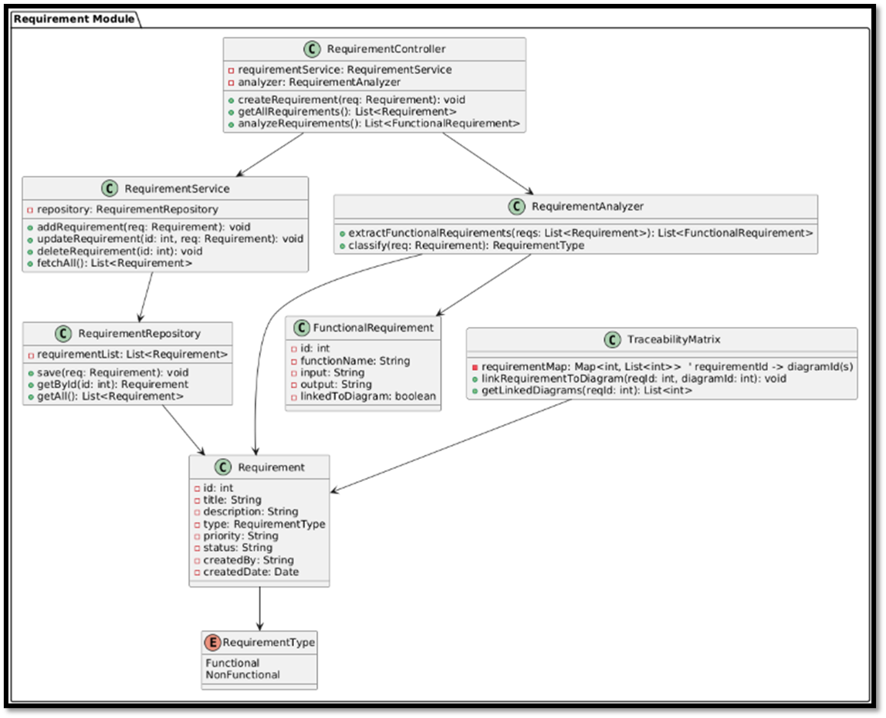
REQUIREMENT ANALYZER

Slide 17
REQUIREMENT ANALYZER
DATABASE DESIGN
REQUIREMENT VERSION
STAKEHOLDERS
REQUIREMENTS
REQUIREMENT COLLABORATORS
requirement_id: Unique identifier
title: requirement name
description: Detail of the requirement
category: Functional, Non-functional
submitted_by: Stakeholder who submitted the requirement
created_at: submission date
version_id: Unique ID
requirement_id: Associated requirement ID
version_number
title: at this version
description: at this version
modified_by: Stakeholder ID who made the modification
modified_at
Time of the modification
collaborator_id: Unique ID
requirement_id: Associated requirement
stakeholder_id: Collaborating stakeholder
role: Reviewer, Editor
assigned_at: time collaboration was assigned
stakeholder_id: unique identifier
name: name of stakeholder
role: role in project

Slide 18

REQUIREMENT ANALYZER
DESIGN PATTERN
creational
Singleton Pattern
Central parser instance
Strategy Pattern
Switch between input formats (e.g., text, JSON)
behavioral

Slide 19
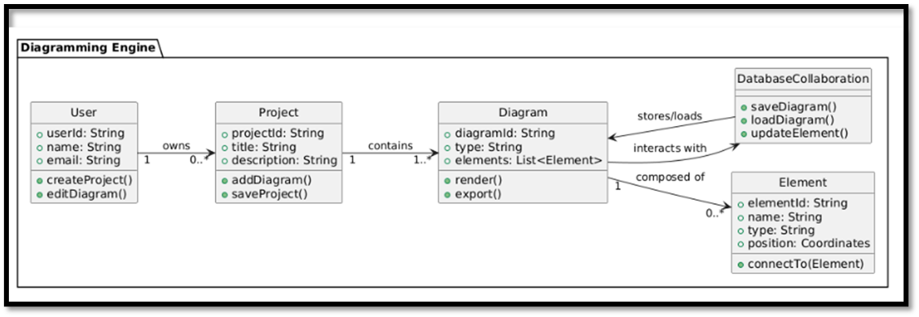
DIAGRAMMING ENGINE

Slide 20
DIAGRAMMING ENGINE
DATABASE DESIGN
DIAGRAM ELEMENTS
COMMENTS
DIAGRAMS
comment_id: Unique comment ID
element_id: Related element ID
user_id: Commenter user ID
content: Comment content
created_at: Creation time
updated_at: Last update time
element_id: Unique element ID
diagram_id: Parent diagram ID
type: Element type
properties: Element properties
position_x: X coordinate
position_y: Y coordinate
created_at: Creation time
updated_at: Last update time
diagram_id: Unique diagram ID
name: Diagram name
project_id: Related project
created_at: Creation time
updated_at: Last update time

Slide 21
DIAGRAMMING ENGINE
DESIGN PATTERN
creational
Factory Pattern
Create diagram elements dynamically
Observer Pattern
behavioral
Update UI on model change

Slide 22
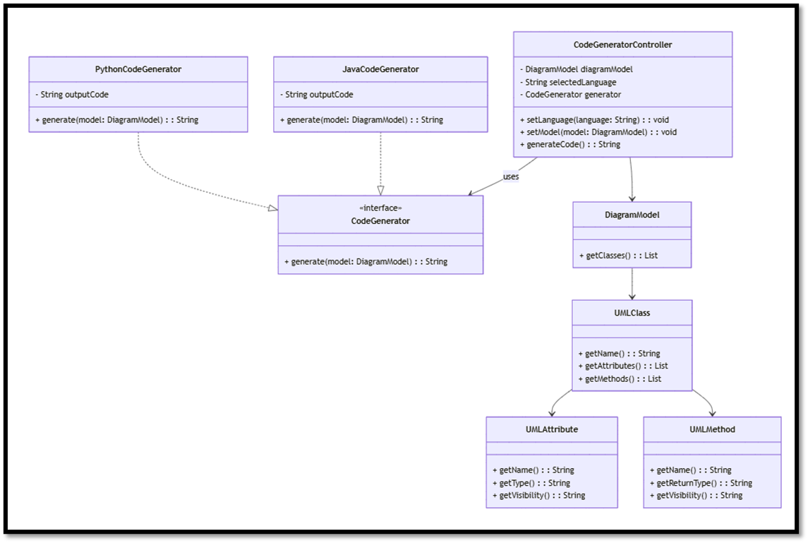
CODE GENERATOR

Slide 23
CODE GENERATOR
DATABASE DESIGN
CODE TEMPLATES
GENERATED CODE LOGS
SUPPORTED LANGUAGE
template_id: Unique template ID
language: Programming language
template_type: Code category
template_body: Template content
created_at: Creation time
updated_at: Last update time
log_id: Unique log ID
diagram_id: Related diagram ID
language: Code language
generated_code: Source code text
generated_by: Initiator user
generated_at: Generation time
language_id: Unique language ID
language_name: Language name
file_extension: Language extension
is_active: Availability flag

Slide 24
CODE GENERATOR
DESIGN PATTERN
creational
Factory Pattern
Generate code components per language
Template Pattern
Language-agnostic generation flow
behavioral

Slide 25
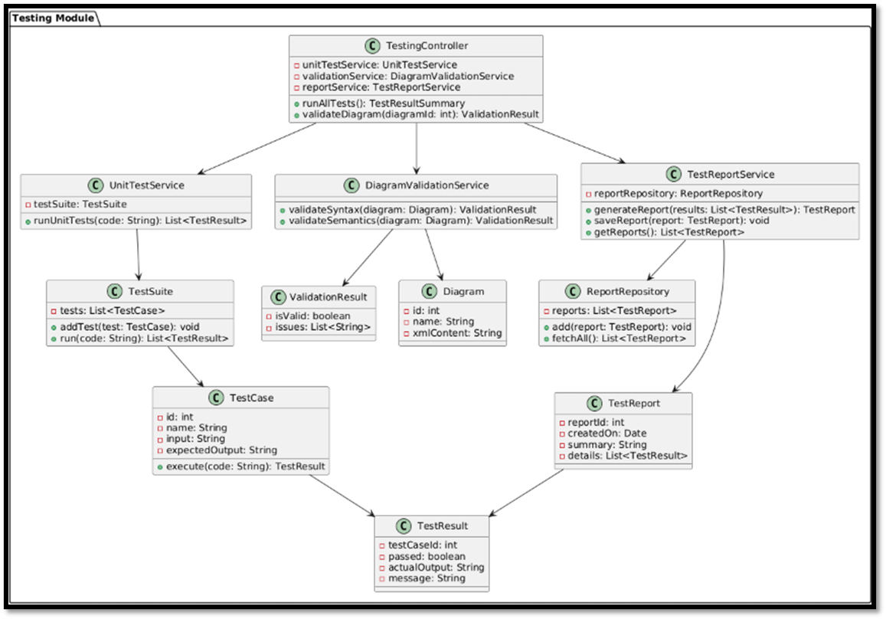
TESTING MODULE

Slide 26
TESTING MODULE
DATABASE DESIGN
TEST PLANS
BUG REPORT
plan_id: Unique plan ID
project_name: Related project name
scope: Test coverage
features_tested: Tested features
features_untested: Untested features
prepared_by: Author of plan
created_at: Creation timestamp
bug_id: Unique bug ID
description: Bug details
severity: Bug severity
priority: Bug priority
steps_to_reproduce: Reproduction steps
expected_result: Ideal output
actual_result: Observed output
status: Bug status
assigned_to: Assigned person

Slide 27
TESTING MODULE
DESIGN PATTERN
Swap test types (unit, functional)
Notify UI of test result changes
Strategy Pattern
behavioral

Slide 28
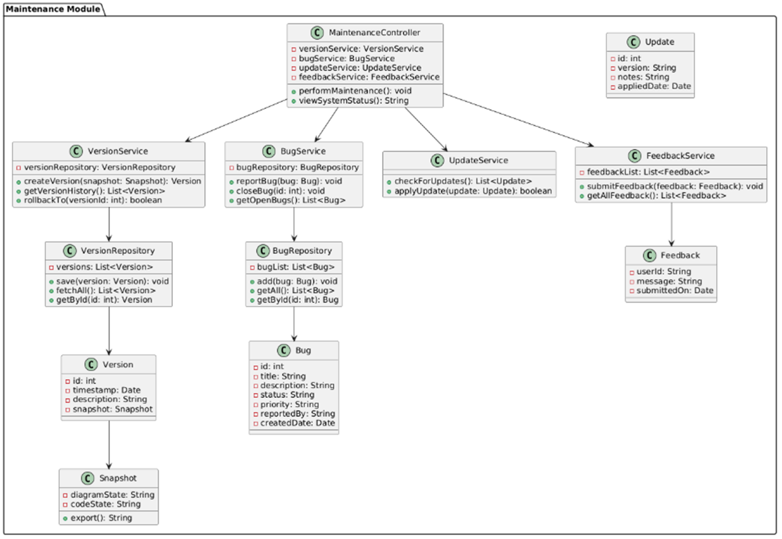
MAINTENANCE

Slide 29
MAINTENANCE
DATABASE DESIGN
PROJECTS
DIAGRAM ELEMENTS
VERSION CONTROL
NOTIFICATIONS
version_id: Unique version ID
project_id: Related project ID
element_id: Related element ID
version_number: Version label
created_at: Version time
created_by: Creator user ID
project_id: Unique project ID
name: Project name
owner_id: Project creator
created_at: Creation time
updated_at: Last update time
element_id: Unique element ID
project_id: Related project ID
element_type: Type of element
position: UI position
created_at: Creation time
notification_id: Unique notification ID
user_id: Recipient user ID
created_at: Notification time

Slide 30
MAINTENANCE
DESIGN PATTERN
creational
Singleton Pattern
Strategy Pattern
Comand Pattern
Enable undo/redo of design/code changes
behavioral

Slide 31

REFRENCE CITATIONS
https://d2u1z1lopyfwlx.cloudfront.net/thumbnails/924ae65a-4f26-5b31-8604-b9e7efb89066/e1552eaa-b7d1-56e6-a296-59dbf0e1db7d.jpg
https://www.tutorialspoint.com/software_architecture_design/introduction.htm
https://www.geeksforgeeks.org/software-design-patterns/
https://www.visual-paradigm.com/
https://www.tutorialspoint.com/mvc_framework/mvc_framework_introduction.htm
https://d2u1z1lopyfwlx.cloudfront.net/thumbnails/924ae65a-4f26-5b31-8604-b9e7efb89066/e1552eaa-b7d1-56e6-a296-59dbf0e1db7d.jpg
https://algomaster.io/learn/lld
https://refactoring.guru/design-patterns

Slide 32
THANK YOU

